Slide 1

DPLUS175: Enhancing monitoring and prevention of invasive non-native species across UKOTs
Helen Roy
Helen Roy

Slide 2

Darwin Plus 2022-2025: Enhancing monitoring and prevention of invasive non-native species across UKOTs
WP1 Establish NNS inventories
WP2 Collaboratively prioritise and develop approaches to implement monitoring and surveillance of INNS
WP3 Pilot modelling approaches to predict spread of INNS across the UKOTs in extreme weather events
WP4 Capacity Building and training

Slide 3
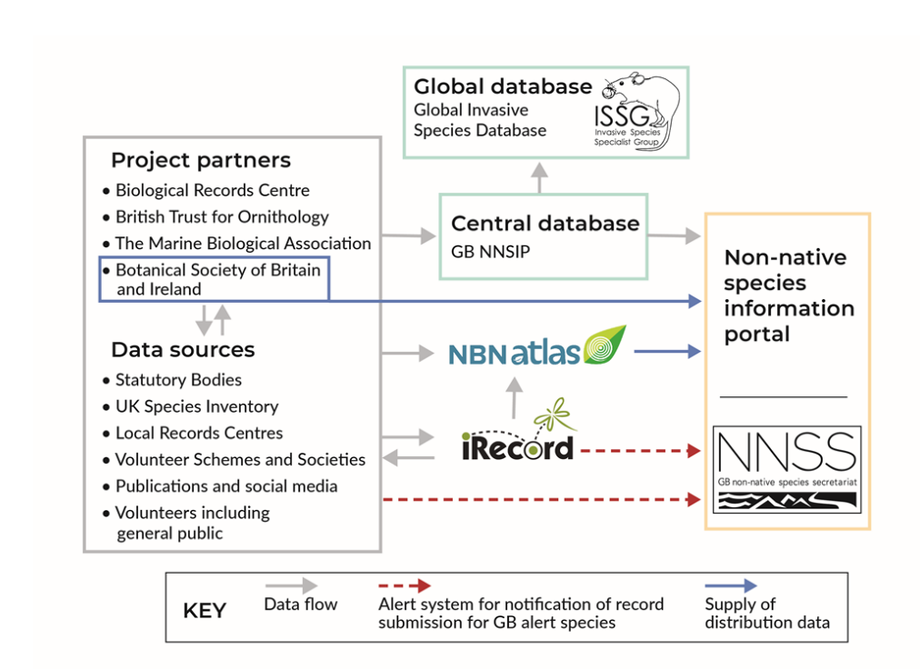

Documenting non-native species in GB

Slide 4
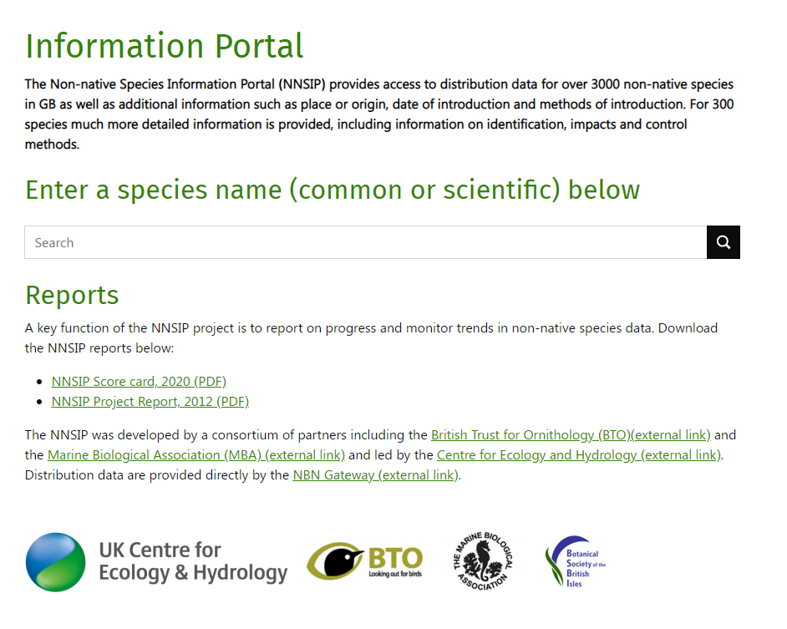


Slide 5
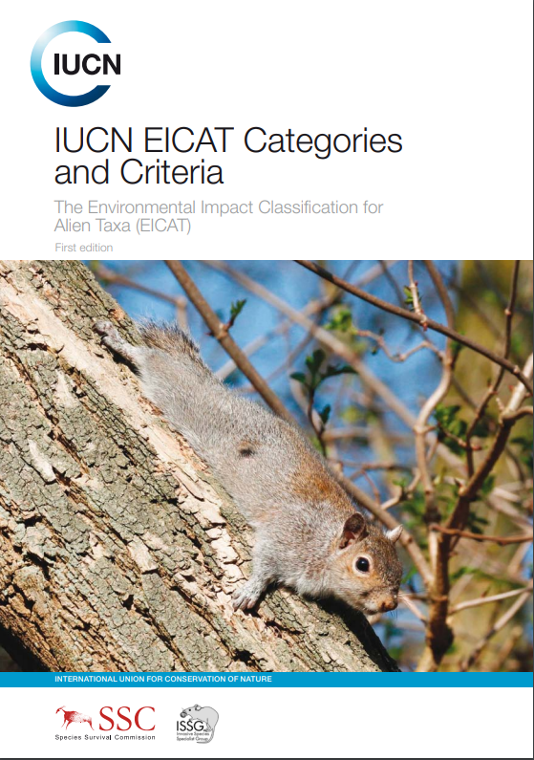

Predicting invasions through horizon scanning…
Systematic examination of potential threats and opportunities within a given context
Teams of experts assess 1000s of species for potential to arrive, establish and adversely impact biodiversity and ecosystems using:
available evidence
expert knowledge
Lists of species from different taxonomic groups and environments compiled
Priority list agreed by consensus

Slide 6

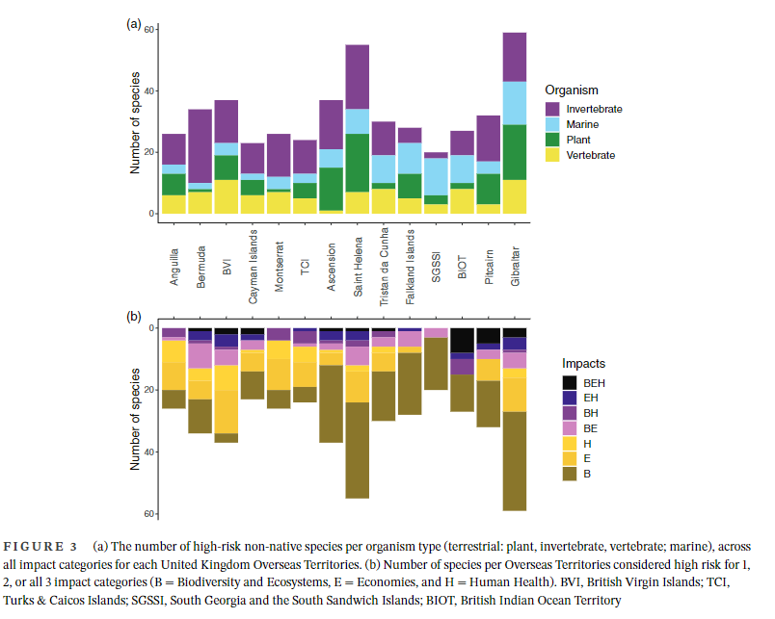

Slide 7
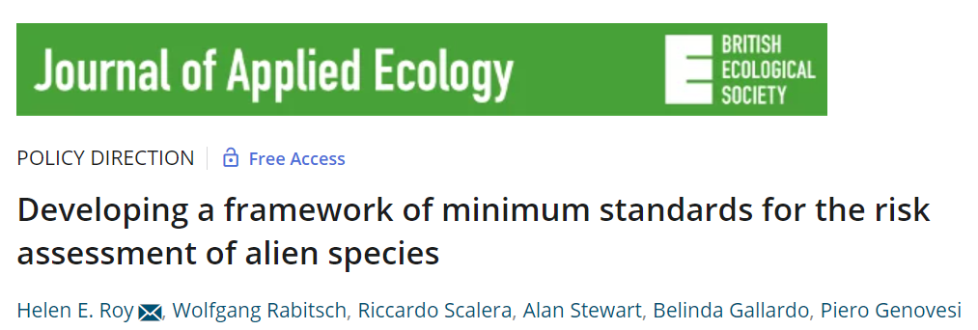
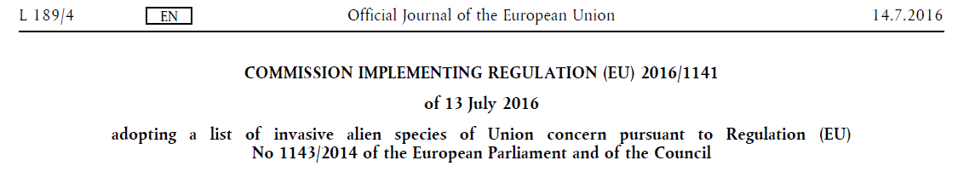
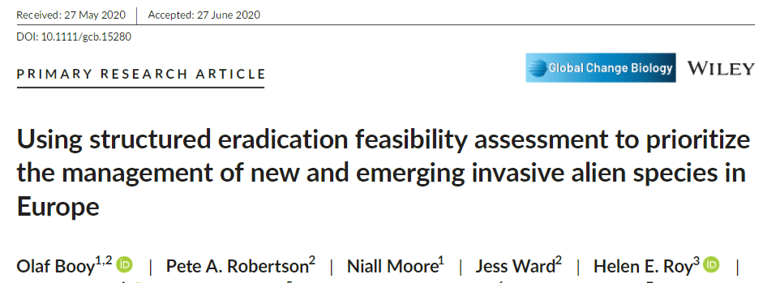


Horizon scanning informing policy and action
…prioritising species for risk assessment
…implementing monitoring and action
…including enhancing biosecurity

