Slide 1

Reporting and visualising information on INNS
Helen Roy
Helen Roy

Slide 2

What reports, visualisations or other outputs on invasive non-native species data would be useful for Montserrat?
Who are the audiences?
What do they need?

Slide 3
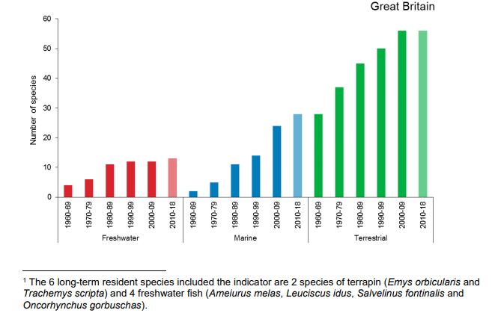



Invasive non-native species indicator

Slide 4
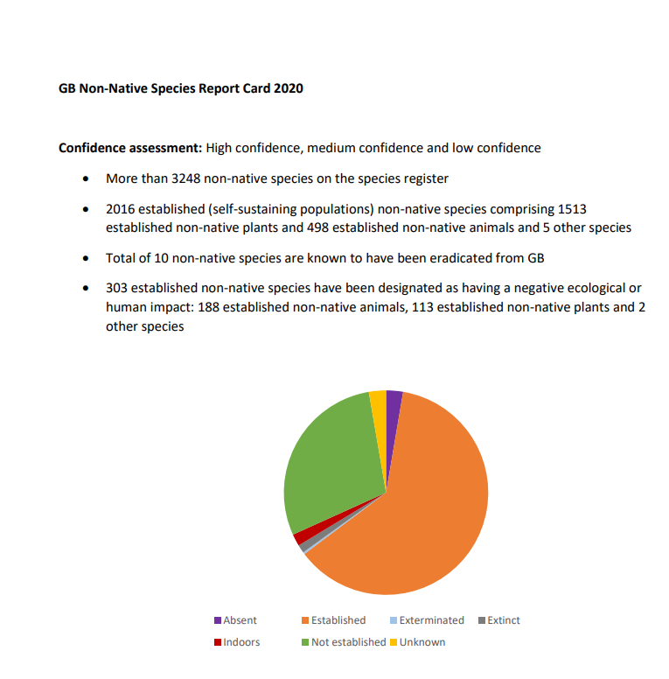
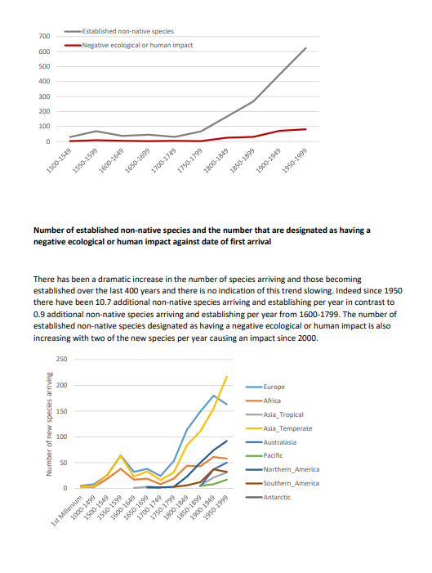
GB Non-Native Species Report Card

Slide 5
Global Biodiversity Framework
TARGET 6
Eliminate, minimize, reduce and or mitigate the impacts of invasive alien species on biodiversity and ecosystem services by identifying and managing pathways of the introduction of alien species, preventing the introduction and establishment of priority invasive alien species, reducing the rates of introduction and establishment of other known or potential invasive alien species by at least 50 per cent, by 2030, eradicating or controlling invasive alien species especially in priority sites, such as islands .

